Slide 1
Strings

Slide 2
String
String provides a lot of concepts that can be performed on a string such as compare, concat, equals, split, length, replace, compareTo, intern, substring etc.
In java, string is basically an object that represents sequence of char values.
An array of characters works same as java string.
Ex:
char[] ch={‘j’,’a’,’v’,’a’};
String s=new String(ch);
String s=“java";

Slide 3
Note
String is immutable i.e. it cannot be changed but a new instance is created. For mutable class, you can use StringBuffer and StringBuilder class.

Slide 4
What is String in java
Generally, string is a sequence of characters. But in java, string is an object that represents a sequence of characters. String class is used to create string object.

Slide 5
How to create String object?
There are two ways to create String object:By string literal
By new keyword

Slide 6
1) String literal
Java String literal is created by using double quotes. For Example:
String s="welcome";
Each time you create a string literal, the JVM checks the string constant pool first. If the string already exists in the pool, a reference to the pooled instance is returned. If string doesn't exist in the pool, a new string instance is created and placed in the pool. For example:
String s1="Welcome";
String s2="Welcome";//will not create new instance

Slide 7
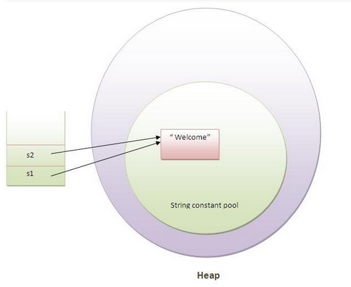
Memory allocation for Strings

Slide 8
***String Constant pool
String objects are stored in a special memory area known as string constant pool.

Slide 9
Why java uses concept of string literal?
To make Java more memory efficient (because no new objects are created if it exists already in string constant pool).

Slide 10
2) By new keyword
String s=new String("Welcome");//creates two objects and one reference variable
In such case, JVM will create a new string object in normal(non pool) heap memory and the literal "Welcome" will be placed in the string constant pool. The variable s will refer to the object in heap(non pool).

Slide 11
String Example
public class StringExample{
public static void main(String args[]){
String s1="java";//creating string by java string literal
char ch[]={'s','t','r','i','n','g','s'};
String s2=new String(ch);//converting char array to string
String s3=new String("example");//creating java string by new keyword
System.out.println(s1);
System.out.println(s2);
System.out.println(s3);
}}

Slide 12
Java String class methods
No. | Method | Description
1 | char charAt(int index) | returns char value for the particular index
2 | int length() | returns string length
3 | static String format(String format, Object... args) | returns formatted string
4 | static String format(Locale l, String format, Object... args) | returns formatted string with given locale
5 | String substring(int beginIndex) | returns substring for given begin index
6 | String substring(int beginIndex, int endIndex) | returns substring for given begin index and end index
7 | boolean contains(CharSequence s) | returns true or false after matching the sequence of char value
8 | static String join(CharSequence delimiter, CharSequence... elements) | returns a joined string
9 | static String join(CharSequence delimiter, Iterable<? extends CharSequence> elements) | returns a joined string
10 | boolean equals(Object another) | checks the equality of string with object
11 | boolean isEmpty() | checks if string is empty
12 | String concat(String str) | concatinates specified string
13 | String replace(char old, char new) | replaces all occurrences of specified char value
14 | String replace(CharSequence old, CharSequence new) | replaces all occurrences of specified CharSequence
15 | String trim() | returns trimmed string omitting leading and trailing spaces

Slide 13
String methods (contd..)
16 | String split(String regex) | returns splitted string matching regex
17 | String split(String regex, int limit) | returns splitted string matching regex and limit
18 | String intern() | returns interned string
19 | int indexOf(int ch) | returns specified char value index
20 | int indexOf(int ch, int fromIndex) | returns specified char value index starting with given index
21 | int indexOf(String substring) | returns specified substring index
22 | int indexOf(String substring, int fromIndex) | returns specified substring index starting with given index
23 | String toLowerCase() | returns string in lowercase.
24 | String toLowerCase(Locale l) | returns string in lowercase using specified locale.
25 | String toUpperCase() | returns string in uppercase.
26 | String toUpperCase(Locale l) | returns string in uppercase using specified locale.

Slide 14
Immutable String in Java
In java, string objects are immutable. Immutable simply means unmodifiable or unchangeable.
Once string object is created its data or state can't be changed but a new string object is created.

Slide 15
Let's try to understand the immutability concept by the example given below:
class Testimmutablestring{
public static void main(String args[]){
String s="Sachin";
s.concat(" Tendulkar");//concat() method appends the string at the end
System.out.println(s);//will print Sachin because strings are immutable objects
}
}

Slide 16
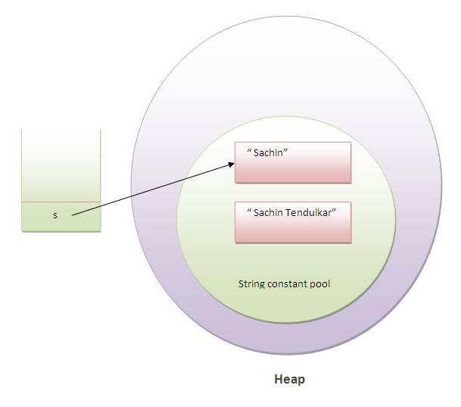
As you can see in the above figure that two objects are created but s reference variable still refers to "Sachin" not to "Sachin Tendulkar".

Slide 17
if we explicitly assign it to the reference variable, it will refer to "Sachin Tendulkar
class Testimmutablestring1{
public static void main(String args[]){
String s="Sachin";
s=s.concat(" Tendulkar");
System.out.println(s);
}
}

Slide 18
Note
In such case, s points to the "Sachin Tendulkar". Please notice that still sachin object is not modified.

Slide 19
***Why string objects are immutable in java?
Because java uses the concept of string literal.Suppose there are 5 reference variables,all referes to one object "sachin".If one reference variable changes the value of the object, it will be affected to all the reference variables. That is why string objects are immutable in java.
Ex:
String city = "Delhi";
String s1 = city;
String s2 = city;
s1 = "Hyd";
String s3 = s1;
System.out.println("City: " +city);
System.out.println("s1: " +s1);
System.out.println("s2: " +s2);
System.out.println("s3: " +s3);

Slide 20
String compare
We can compare string in java on the basis of content and reference.
It is used in authentication (by equals() method), sorting (by compareTo() method), reference matching (by == operator) etc.
By equals() method
By = = operator
By compareTo() method

Slide 21
1) String compare by equals() method
The String equals() method compares the original content of the string. It compares values of string for equality. String class provides two methods:
public boolean equals(Object another) compares this string to the specified object.
public boolean equalsIgnoreCase(String another) compares this String to another string, ignoring case.

Slide 22
String compare by equals() method
class Teststringcomparison1{
public static void main(String args[]){
String s1="Sachin";
String s2="Sachin";
String s3=new String("Sachin");
String s4="Saurav";
String s5 =“SACHIN";
System.out.println(s1.equals(s2));//true
System.out.println(s1.equals(s3));//true
System.out.println(s1.equals(s4));//false
System.out.println(s1.equals(s5));//false
System.out.println(s1.equalsIgnoreCase(s5));//true
}
}

Slide 23
2. String compare by == operator The = = operator compares references not values.
class Teststringcomparison3{
public static void main(String args[]){
String s1="Sachin";
String s2="Sachin";
String s3=new String("Sachin");
System.out.println(s1==s2);//true (because both refer to same instance)
System.out.println(s1==s3);//false(because s3 refers to instance created in nonpool)
}
}

Slide 24
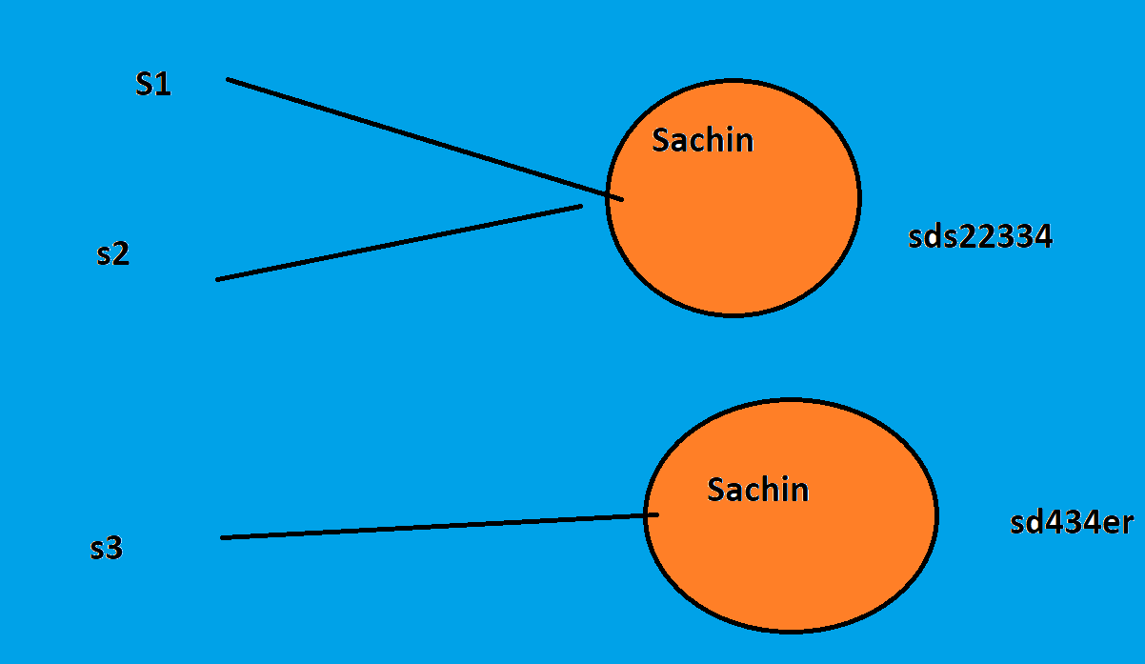
Memory Allocation

Slide 25
3) String compare by compareTo() method
The String compareTo() method compares values lexicographically and returns an integer value that describes if first string is less than, equal to or greater than second string.
Suppose s1 and s2 are two string variables. If:
s1 == s2 :0
s1 > s2 :positive value
s1 < s2 :negative value

Slide 26
Example of compareTo()
class Teststringcomparison4{
public static void main(String args[]){
String s1="Sachin";
String s2="Sachin";
String s3="Ratan";
System.out.println(s1.compareTo(s2));//0
System.out.println(s1.compareTo(s3));//1(because s1>s3)
System.out.println(s3.compareTo(s1));//-1(because s3 < s1 )
}
}

Slide 27
String Concatenation

Slide 28
String Concatenation
In java, string concatenation forms a new string that is the combination of multiple strings. There are two ways to concat string in java:
By + (string concatenation) operator
By concat() method

Slide 29
1) String Concatenation by + (string concatenation) operator
class TestStringConcatenation1{
public static void main(String args[]){
String s="Sachin"+" Tendulkar";
System.out.println(s);//Sachin Tendulkar
}
}

Slide 30
Note
The Java compiler transforms above code to this:
String s=(new StringBuilder()).append("Sachin").append(" Tendulkar).toString();
In java, String concatenation is implemented through the StringBuilder (or StringBuffer) class and its append method. String concatenation operator produces a new string by appending the second operand onto the end of the first operand. The string concatenation operator can concat not only string but primitive values also. For Example:
String s=50+30+"Sachin"+40+40;
System.out.println(s);//80Sachin4040

Slide 31
2) String Concatenation by concat() method
class TestStringConcatenation{
public static void main(String args[]){
String s1="Sachin ";
String s2="Tendulkar";
String s3=s1.concat(s2);
System.out.println(s3);//Sachin Tendulkar
}
}

Slide 32
Substring

Slide 33
Substring
A part of string is called substring. In other words, substring is a subset of another string. In case of substring startIndex is inclusive and endIndex is exclusive.
Note: index starts from 0

Slide 34
substring methods
public String substring(int startIndex): This method returns new String object containing the substring of the given string from specified startIndex (inclusive).
public String substring(int startIndex, int endIndex): This method returns new String object containing the substring of the given string from specified startIndex to endIndex.
In case of string:
startIndex: inclusive
endIndex: exclusive
Ex:
String s="hello";
System.out.println(s.substring(0,2));//he

Slide 35
Example of substring
public class TestSubstring{
public static void main(String args[]){
String s="Sachin Tendulkar";
System.out.println(s.substring(7));//Tendulkar
System.out.println(s.substring(0,6));//Sachin
}
}

Slide 36
String class methods

Slide 37
String class methods
The java.lang.String class provides a lot of methods to work on string. By the help of these methods, we can perform operations on string such as trimming, concatenating, converting, comparing, replacing strings etc.
Java String is a powerful concept because everything is treated as a string if you submit any form in window based, web based or mobile application.

Slide 38
String toUpperCase() and toLowerCase() method
String s="Sachin";
System.out.println(s.toUpperCase());//SACHIN
System.out.println(s.toLowerCase());//sachin
System.out.println(s);//Sachin(no change in original)

Slide 39
String trim() method
String s=" Sachin ";
System.out.println(s);// Sachin
System.out.println(s.trim());//Sachin

Slide 40
Java String startsWith() and endsWith() method
String s="Sachin";
System.out.println(s.startsWith("Sa"));//true
System.out.println(s.endsWith("n"));//true

Slide 41
String charAt() method
String s="Sachin";
System.out.println(s.charAt(0));//S
System.out.println(s.charAt(3));//h

Slide 42
length()
String s="Sachin";
System.out.println(s.length());//6

Slide 43
String intern() method
A pool of strings, initially empty, is maintained privately by the class String.
When the intern method is invoked, if the pool already contains a string equal to this String object as determined by the equals(Object) method, then the string from the pool is returned. Otherwise, this String object is added to the pool and a reference to this String object is returned.
String s=new String("Sachin");
String s2=s.intern();
System.out.println(s2);//Sachin

Slide 44
String valueOf() method
The string valueOf() method coverts given type such as int, long, float, double, boolean, char and char array into string.
int a=10;
String s=String.valueOf(a);
System.out.println(s+10);

Slide 45
String replace() method
The string replace() method replaces all occurrence of first sequence of characters with second sequence of characters.
String s1="Java is a programming language. Java is a platform. Java is an Island.";
String replaceString=s1.replace("Java","Kava");//replaces all occurrences of "Java" to "Kava"
System.out.println(replaceString);

Slide 46
StringBuffer class
StringBuffer class is used to created mutable (modifiable) string. The StringBuffer class in java is same as String class except it is mutable i.e. it can be changed.

Slide 47
Note
StringBuffer class is thread-safe i.e. multiple threads cannot access it simultaneously. So it is safe and will result in an order.

Slide 48
Important Constructors of StringBuffer class
StringBuffer(): creates an empty string buffer with the initial capacity of 16.
StringBuffer(String str): creates a string buffer with the specified string.
StringBuffer(int capacity): creates an empty string buffer with the specified capacity as length.

Slide 49
Important methods of StringBuffer class
public synchronized StringBuffer append(String s): is used to append the specified string with this string. The append() method is overloaded like append(char), append(boolean), append(int), append(float), append(double) etc.
public synchronized StringBuffer insert(int offset, String s): is used to insert the specified string with this string at the specified position. The insert() method is overloaded like insert(int, char), insert(int, boolean), insert(int, int), insert(int, float), insert(int, double) etc.
public synchronized StringBuffer replace(int startIndex, int endIndex, String str): is used to replace the string from specified startIndex and endIndex.
public synchronized StringBuffer delete(int startIndex, int endIndex): is used to delete the string from specified startIndex and endIndex.
public synchronized StringBuffer reverse(): is used to reverse the string.
public int capacity(): is used to return the current capacity.
public void ensureCapacity(int minimumCapacity): is used to ensure the capacity at least equal to the given minimum.
public char charAt(int index): is used to return the character at the specified position.
public int length(): is used to return the length of the string i.e. total number of characters.
public String substring(int beginIndex): is used to return the substring from the specified beginIndex.
public String substring(int beginIndex, int endIndex): is used to return the substring from the specified beginIndex and endIndex.

Slide 50
What is mutable string
A string that can be modified or changed is known as mutable string. StringBuffer and StringBuilder classes are used for creating mutable string.

Slide 51
1) StringBuffer append() method
The append() method concatenates the given argument with this string.
class A{
public static void main(String args[]){
StringBuffer sb=new StringBuffer("Hello ");
sb.append("Java");//now original string is changed
System.out.println(sb);//prints Hello Java
}
}

Slide 52
2) StringBuffer insert() method
The insert() method inserts the given string with this string at the given position.
class A{
public static void main(String args[]){
StringBuffer sb=new StringBuffer("Hello ");
sb.insert(1,"Java");//now original string is changed
System.out.println(sb);//prints HJavaello
}
}

Slide 53
3) StringBuffer replace() method
The replace() method replaces the given string from the specified begin Index and end Index.
class A{
public static void main(String args[]){
StringBuffer sb=new StringBuffer("Hello");
sb.replace(1,3,"Java");
System.out.println(sb);//prints HJavalo
}
}

Slide 54
4) StringBuffer delete() method
The delete() method of StringBuffer class deletes the string from the specified beginIndex to endIndex.
class A{
public static void main(String args[]){
StringBuffer sb=new StringBuffer("Hello");
sb.delete(1,3);
System.out.println(sb);//prints Hlo
}
}

Slide 55
5) StringBuffer reverse() method
The reverse() method of StringBuilder class reverses the current string.
class A{
public static void main(String args[]){
StringBuffer sb=new StringBuffer("Hello");
sb.reverse();
System.out.println(sb);//prints olleH
}
}

Slide 56
WAP to reverse a string without using predefined reverse() method StringBuffer
public class StringReverse {
public static void main(String[] args) {
String s = "MADAM";
int len = s.length();
for (int i = len-1; i >=0; i--) {
System.out.print(s.charAt(i));
} } }

Slide 57
StringBuilder class
Java StringBuilder class is used to create mutable (modifiable) string. The Java StringBuilder class is same as StringBuffer class except that it is non-synchronized. It is available since JDK 1.5.

Slide 58
Important Constructors of StringBuilder class
StringBuilder(): creates an empty string Builder with the initial capacity of 16.
StringBuilder(String str): creates a string Builder with the specified string.
StringBuilder(int length): creates an empty string Builder with the specified capacity as length.

Slide 59
Important methods of StringBuilder class
Method | Description
public StringBuilder append(String s) | is used to append the specified string with this string. The append() method is overloaded like append(char), append(boolean), append(int), append(float), append(double) etc.
public StringBuilder insert(int offset, String s) | is used to insert the specified string with this string at the specified position. The insert() method is overloaded like insert(int, char), insert(int, boolean), insert(int, int), insert(int, float), insert(int, double) etc.
public StringBuilder replace(int startIndex, int endIndex, String str) | is used to replace the string from specified startIndex and endIndex.
public StringBuilder delete(int startIndex, int endIndex) | is used to delete the string from specified startIndex and endIndex.
public StringBuilder reverse() | is used to reverse the string.
public int capacity() | is used to return the current capacity.
public void ensureCapacity(int minimumCapacity) | is used to ensure the capacity at least equal to the given minimum.
public char charAt(int index) | is used to return the character at the specified position.
public int length() | is used to return the length of the string i.e. total number of characters.
public String substring(int beginIndex) | is used to return the substring from the specified beginIndex.
public String substring(int beginIndex, int endIndex) | is used to return the substring from the specified beginIndex and endIndex.

Slide 60
StringBuilder append() method
The StringBuilder append() method concatenates the given argument with this string.
class A{
public static void main(String args[]){
StringBuilder sb=new StringBuilder("Hello ");
sb.append("Java");//now original string is changed
System.out.println(sb);//prints Hello Java
}
}

Slide 61
2) StringBuilder insert() method
The StringBuilder insert() method inserts the given string with this string at the given position.
class A{
public static void main(String args[]){
StringBuilder sb=new StringBuilder("Hello ");
sb.insert(1,"Java");//now original string is changed
System.out.println(sb);//prints HJavaello
}
}

Slide 62
3) StringBuilder replace() method
The StringBuilder replace() method replaces the given string from the specified beginIndex and endIndex.
class A{
public static void main(String args[]){
StringBuilder sb=new StringBuilder("Hello");
sb.replace(1,3,"Java");
System.out.println(sb);//prints HJavalo
}
}

Slide 63
4) StringBuilder delete() method
The delete() method of StringBuilder class deletes the string from the specified begi
class A{
public static void main(String args[]){
StringBuilder sb=new StringBuilder("Hello");
sb.delete(1,3);
System.out.println(sb);//prints Hlo
}
}
nIndex to endIndex.

Slide 64
4) StringBuilder delete() method
The delete() method of StringBuilder class deletes the string from the specified beginIndex to endIndex.
class A{
public static void main(String args[]){
StringBuilder sb=new StringBuilder("Hello");
sb.delete(1,3);
System.out.println(sb);//prints Hlo
}
}

Slide 65
5) StringBuilder reverse() method
The reverse() method of StringBuilder class reverses the current string.
class A{
public static void main(String args[]){
StringBuilder sb=new StringBuilder("Hello");
sb.reverse();
System.out.println(sb);//prints olleH
}
}

Slide 66
***Guess the output
StringBuffer sb = new StringBuffer("amr");
StringBuffer sb1 = new StringBuffer("amr");
System.out.println(sb.equals(sb1));

Slide 67
answer
False
Reason: StringBuffer didn’t implement equals method

Slide 68
Difference between String and StringBuffer
No. | String | StringBuffer
1) | String class is immutable. | StringBuffer class is mutable.
2) | String is slow and consumes more memory when you concat too many strings because every time it creates new instance. | StringBuffer is fast and consumes less memory when you cancat strings.
3) | String class overrides the equals() method of Object class. So you can compare the contents of two strings by equals() method. | StringBuffer class doesn't override the equals() method of Object class.

Slide 69
Difference between StringBuffer and StringBuilder
No. | StringBuffer | StringBuilder
1) | StringBuffer is synchronized i.e. thread safe. It means two threads can't call the methods of StringBuffer simultaneously. | StringBuilder is non-synchronized i.e. not thread safe. It means two threads can call the methods of StringBuilder simultaneously.
2) | StringBuffer is less efficient than StringBuilder. | StringBuilder is more efficient than StringBuffer.

Slide 70
***How to create Immutable class?
There are many immutable classes like String, Boolean, Byte, Short, Integer, Long, Float, Double etc.
In short, all the wrapper classes and String class is immutable.
We can also create immutable class by creating final class that have final data members as the example given below:

Slide 71
TestWrapper classes which are mutable or not? All wrapper classes are immutable
public class TestWrapperClasses {
public static void main(String[] args) {
Integer i = 10;
System.out.println(i.hashCode());
i = i + 10;
System.out.println(i.hashCode());
Double d = 10.45;
System.out.println(d.hashCode());
d = d + 10;
System.out.println(d.hashCode());
}
}

Slide 72
Example to create Immutable class
we have created a final class named Employee. It have one final datamember, a parameterized constructor and getter method.
public final class Employee{
final String pancardNumber;
public Employee(String pancardNumber){
this.pancardNumber=pancardNumber;
}
public String getPancardNumber(){
return pancardNumber;
} }

Slide 73
Note
The instance variable of the class is final i.e. we cannot change the value of it after creating an object.
The class is final so we cannot create the subclass.
There is no setter methods i.e. we have no option to change the value of the instance variable.

Slide 74
toString() method
If you want to represent any object as a string, toString() method comes into existence.
The toString() method returns the string representation of the object.
If you print any object, java compiler internally invokes the toString() method on the object. So overriding the toString() method, returns the desired output, it can be the state of an object etc. depends on your implementation.

Slide 75
Advantage of toString() method
By overriding the toString() method of the Object class, we can return values of the object, so we don't need to write much code.

Slide 76
Understanding problem without toString() method
//Let's see the simple code that prints reference.
class Student{
int rollno;
String name;
String city;
Student(int rollno, String name, String city){
this.rollno=rollno;
this.name=name;
this.city=city;
}
public static void main(String args[]){
Student s1=new Student(101,"Raj","lucknow");
Student s2=new Student(102,"Vijay","ghaziabad");
System.out.println(s1);//compiler writes here s1.toString()
System.out.println(s2);//compiler writes here s2.toString()
}
}

Slide 77
Output
As you can see in the above example, printing s1 and s2 prints the hashcode values of the objects but I want to print the values of these objects.
Since java compiler internally calls toString() method, overriding this method will return the specified values. Let's understand it with the example given below:

Slide 78
Example of toString() method
class Student{
int rollno;
String name;
String city;
Student(int rollno, String name, String city){
this.rollno=rollno;
this.name=name;
this.city=city;
}
public String toString(){//overriding the toString() method
return rollno+" "+name+" "+city;
}
public static void main(String args[]){
Student s1=new Student(101,"Raj","lucknow");
Student s2=new Student(102,"Vijay","ghaziabad");
System.out.println(s1);//compiler writes here s1.toString()
System.out.println(s2);//compiler writes here s2.toString()
} }

Slide 79
StringTokenizer
The java.util.StringTokenizer class allows you to break a string into tokens. It is simple way to break string.
It doesn't provide the facility to differentiate numbers, quoted strings, identifiers etc

Slide 80
Methods of StringTokenizer class
Public method | Description
boolean hasMoreTokens() | checks if there is more tokens available.
String nextToken() | returns the next token from the StringTokenizer object.
String nextToken(String delim) | returns the next token based on the delimeter.
boolean hasMoreElements() | same as hasMoreTokens() method.
Object nextElement() | same as nextToken() but its return type is Object.
int countTokens() | returns the total number of tokens.

Slide 81
Example of nextToken(String delim) method of StringTokenizer class
import java.util.StringTokenizer;
public class Test {
public static void main(String[] args) {
String name= "My~name~is~MangaRao";
StringTokenizer st = new StringTokenizer(name,"~");
while(st.hasMoreTokens()){
System.out.println(st.nextToken());
} } }

Slide 82
Spilt() method
public class Test{
public static void main(String[] args) {
String name = "My~name~is~MangaRao";
String[] names = name.split("~");
for (int i = 0; i < names.length; i++) {
System.out.println(names[i]);
} } }

Slide 83
Note
StringTokenizer class is deprecated now.
It is recommended to use split() method of String class

Slide 84
***Why character array is better than String for Storing password in Java
Since Strings are immutable in Java if you store password as plain text it will be available in memory until Garbage collector clears it and since String are used in String pool for reusability there is pretty high chance that it will be remain in memory for long duration, which pose a security threat. Since anyone who has access to memory dump can find the password in clear text and that's another reason you should always use an encrypted password than plain text. Since Strings are immutable there is no way contents of Strings can be changed because any change will produce new String, while if you char [] you can still set all his element as blank or zero. So Storing password in character array clearly mitigates security risk of stealing password

Slide 85
